Slide 1
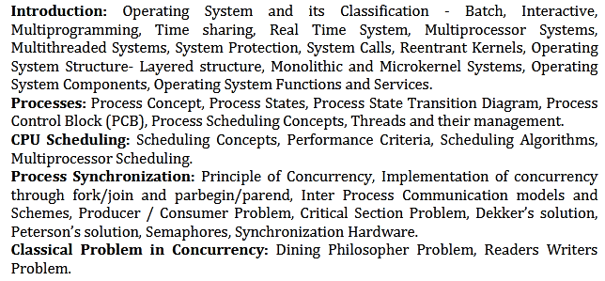
BCSE 0004
Operating System
Dr. Ajitesh Kumar
Module 1

Slide 2
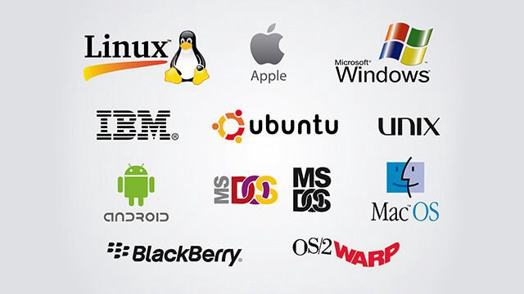
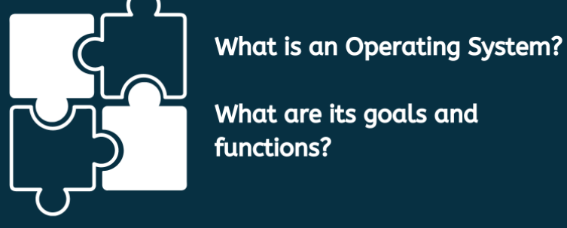
BCSE 0004
Operating System

Slide 3
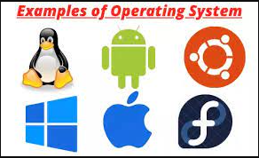
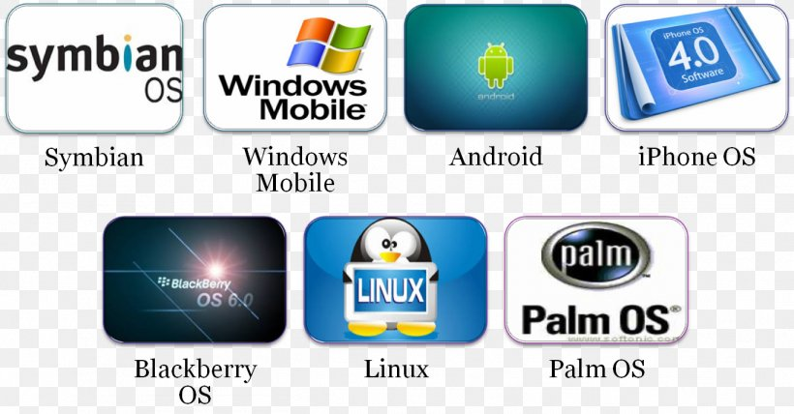
What is an Operating System?
A program that acts as an intermediary between a user of a computer and the computer hardware
Operating system goals:
Execute user programs and make solving user problems easier
Make the computer system convenient to use
Use the computer hardware in an efficient manner
“The one program running at all times on the computer” (kernel).
Everything else is either
a system program (ships with the operating system) , or
an application program.

Slide 4
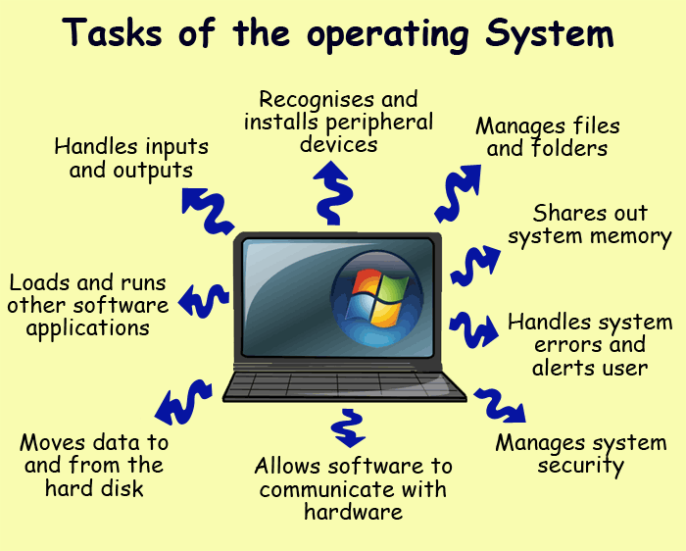
Task of Operating System [Services]
Accepts inputs from the mouse or keyboard.
Sends outputs to the monitor or printer.
Recognises peripheral devices such as external hard disks, pen drive, web cam etc. and makes sure that software needed for the hardware to run is installed.
Manages files and folders in the system (Naming, Creating, Moving, Finding and Deleting folders etc.).
Allows applications software (word-processing, spreadsheets etc.) to communicate with the system's hardware.
Shares out system memory efficiently. The operating system will decide how much memory to assign to particular tasks. It also moves data in and out of memory.
Loads and runs software applications.
Manages system security. For example - allows passwords to be added / changed.
Handles system problems and alerts the user
Manages the moving of data to and from a hard disk.

Slide 5
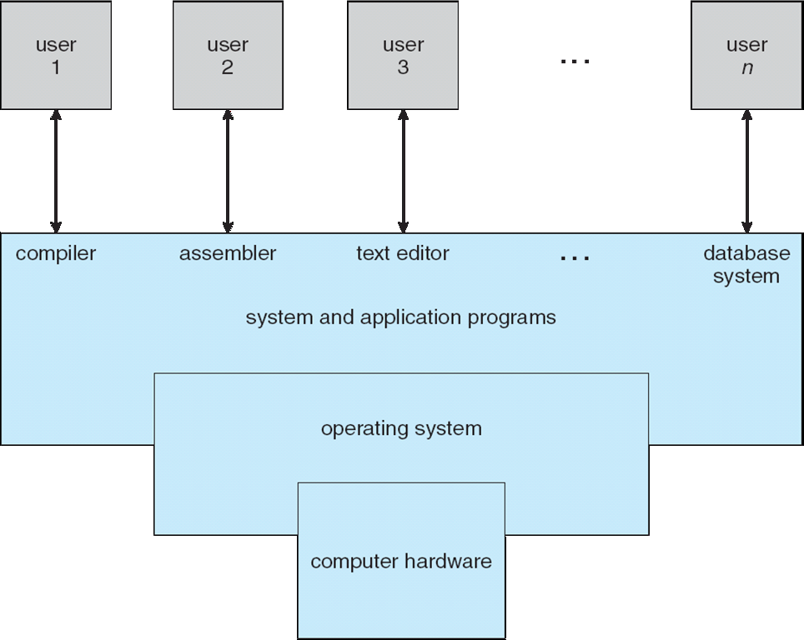
Computer System Structure
Computer system can be divided into four components:
Hardware – provides basic computing resources
CPU, memory, I/O devices
Operating system
Controls and coordinates use of hardware among various applications and users
Application programs – define the ways in which the system resources are used to solve the computing problems of the users
Word processors, compilers, web browsers, database systems, video games
Users
People, machines, other computers

Slide 6
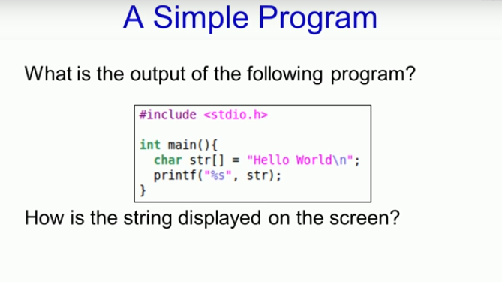
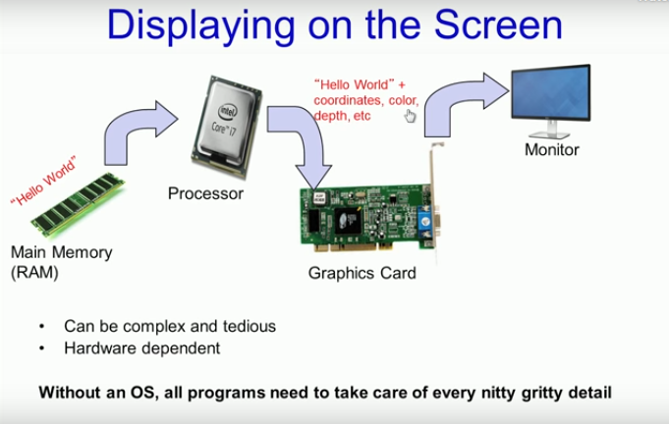
Resources Required from OS by a Program
Execution of a simple program requires so many resources. THINK what for a bigger line of code program.
So much Complexity…..( Thank GOD, it is managed by Operating System )

Slide 7

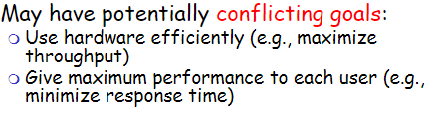
Operating System- One Application, Many Views
OS is a resource allocator
Manages all resources
Decides between conflicting requests for efficient and fair resource use
OS is a control program
Controls execution of programs to prevent errors and improper use of the computer
An operating system is a software program that manages computer resources. Operating systems allow components to communicate with each other and enables the computer to run software applications.“
The software layer between user applications and hardware.
Provides an abstraction for hardware through an interface to the hardware.

Slide 8
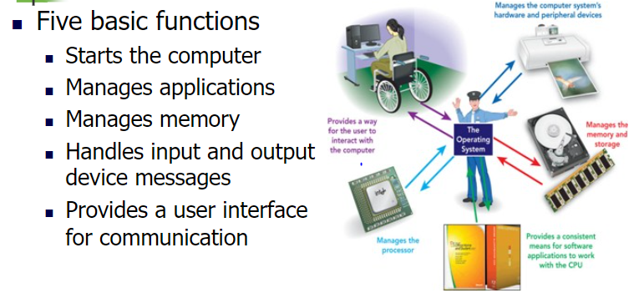
Operating System- Functions

Slide 9
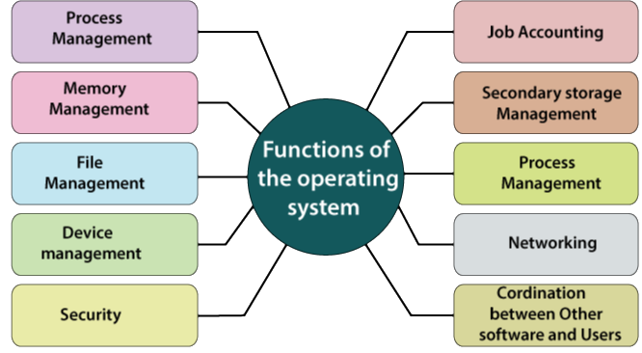
Operating System- Functions
Processor Management: An operating system manages the processor’s working by allocating various jobs to it
Memory Management: An operating system manages the allocation and deallocation of the memory.
Device Management: An operating system controls the working of input-output devices.
File Management: An operating system keeps track of information regarding the creation, deletion, transfer, copy, and storage of files in an organized way
Security: The operating system provides following security measures to protect user data:
Protection against unauthorized access through login.
Protection against intrusion by keeping Firewall active.
Protecting the system memory against malicious access.
Displaying messages related to system vulnerabilities.
Error Detection: From time to time, It also checks the hardware for any type of damage. Job Scheduling: While multitasking the operating system determines which applications should run in which sequence.

Slide 10
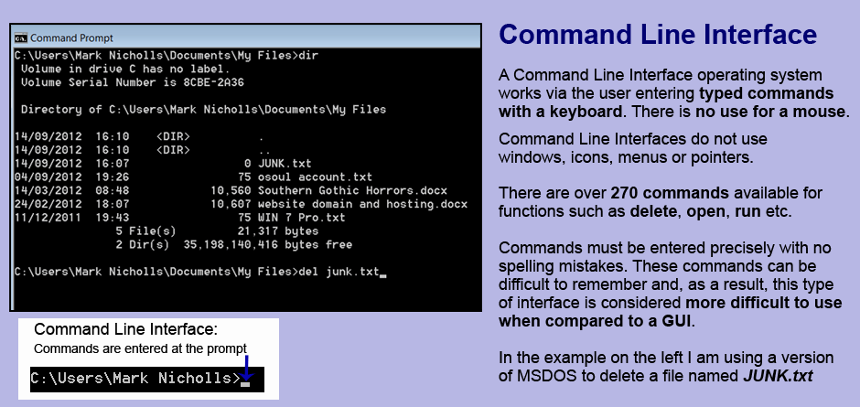
Operating System- Types of Interface- CLI

Slide 11
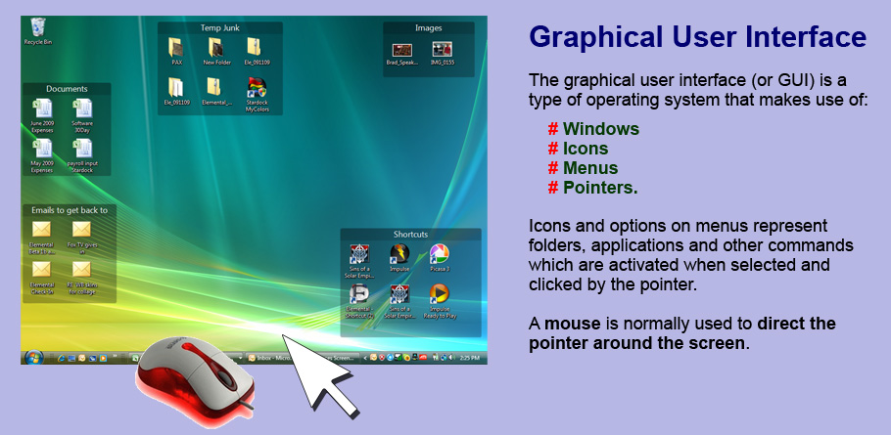
Operating System- Types of Interface- GUI

Slide 12
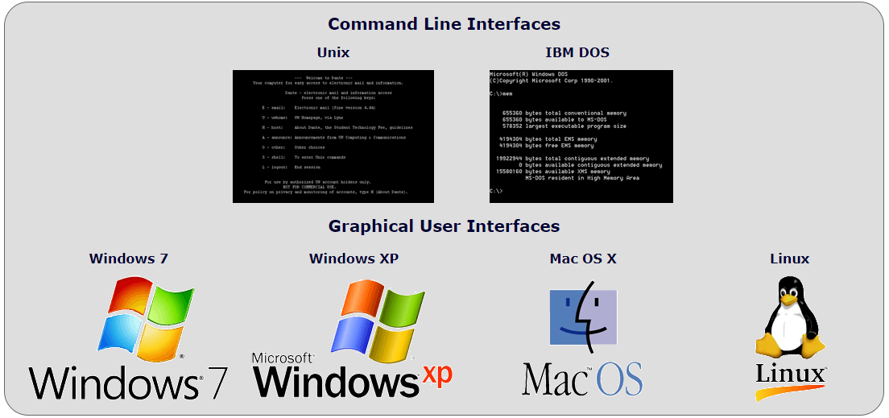

Slide 13
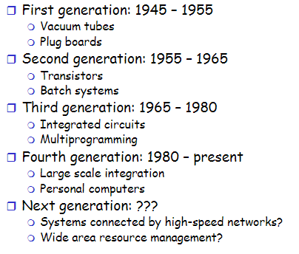
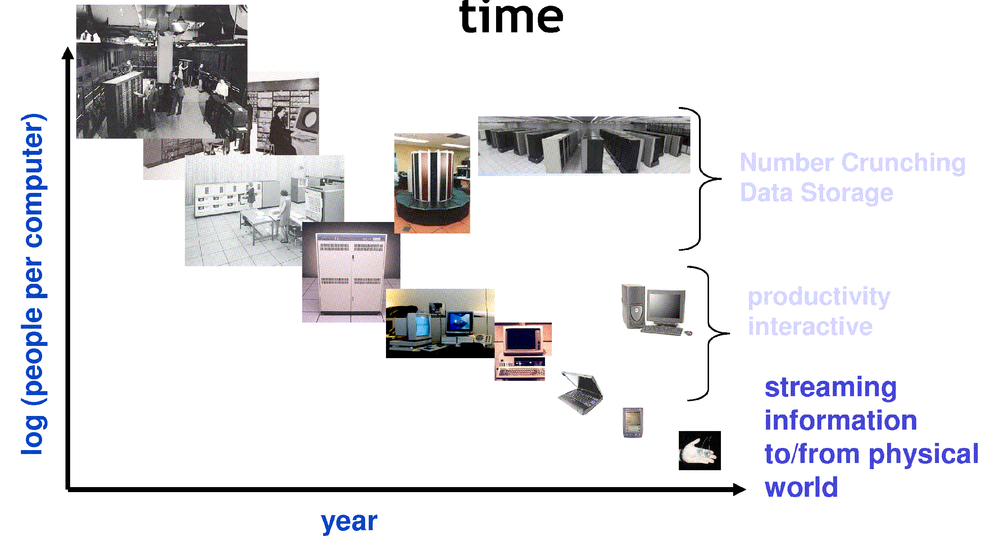
Operating System- Evolution (History and Generations)
The history & evolution of operating systems have been tightly related to the history & evolution of computer systems over time.

Slide 14
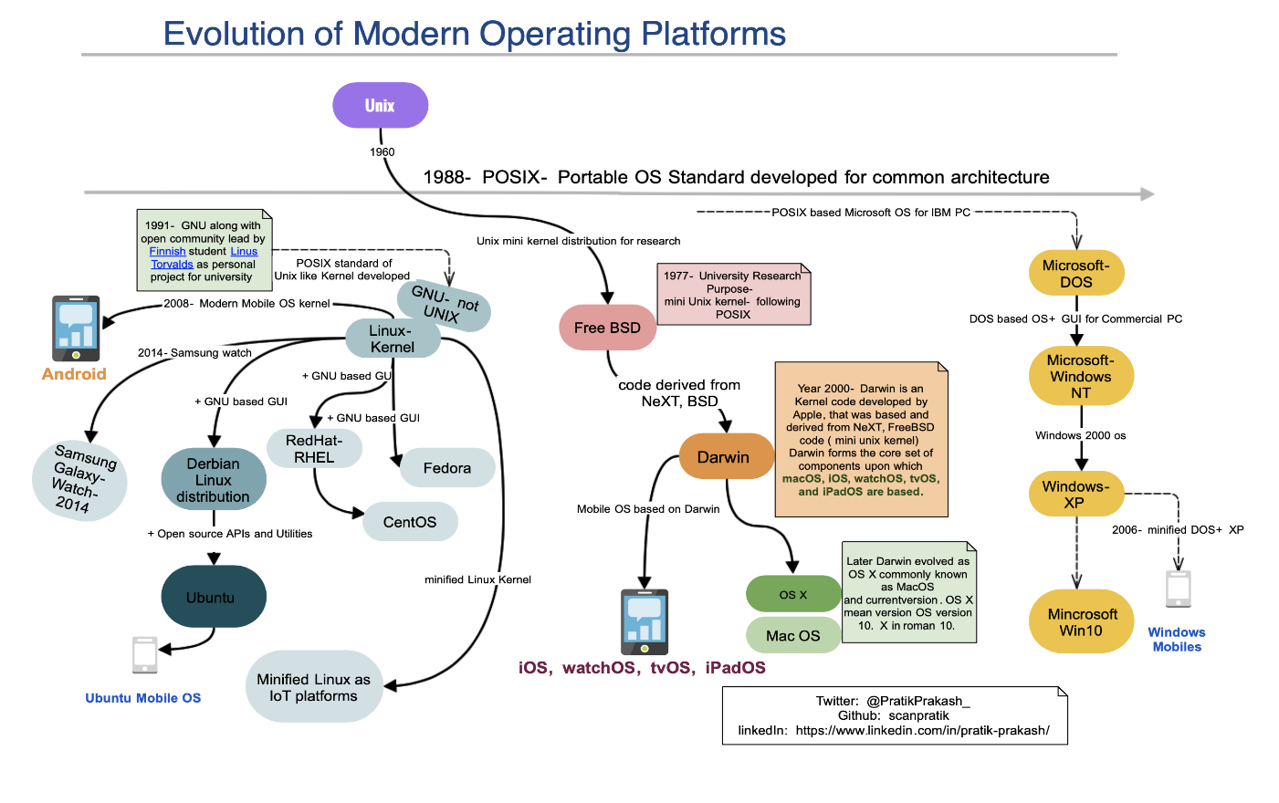

Slide 15
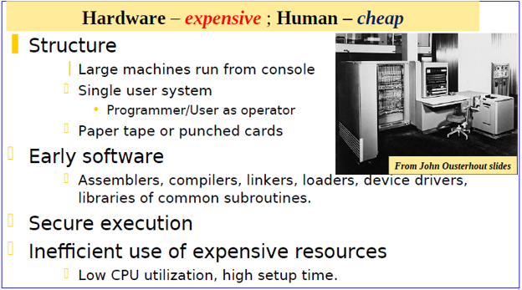
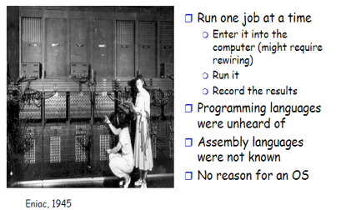
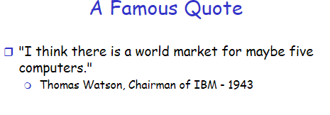
First Generation: Direct Input (BARE MACHINE) 1945-55
Mechanical Parts, Vacuum Tubes and Plug Boards

Slide 16
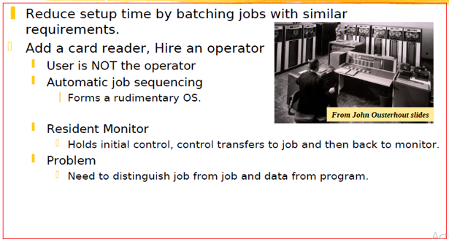
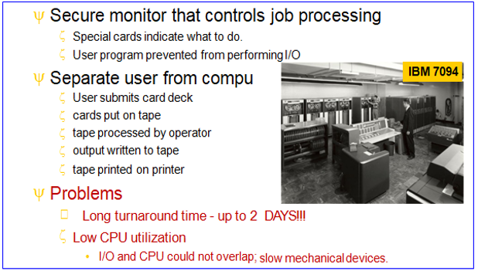
Second Generation: Simple BATCH System
Transistors were used instead of vacuum tubes.
These are also called single-stream batch processing system. These computers were called mainframes used in large rooms by professional engineers & could perform a single task at a time

Slide 17
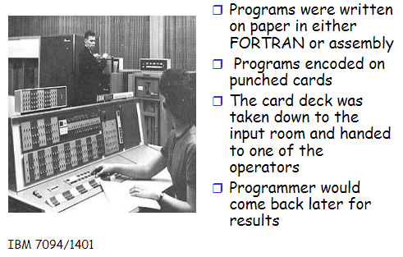
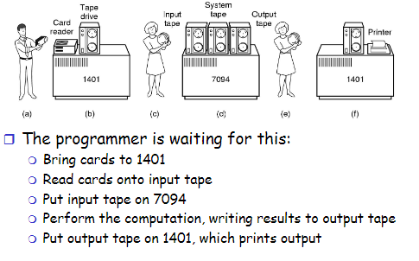
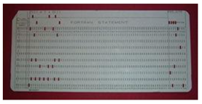
Second Generation: Simple BATCH System
2 major issues in BATCH System
I/O- Electrical devices speed mismatch
CPU-I/O time not overlapping

Slide 18
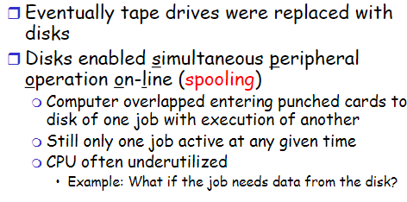
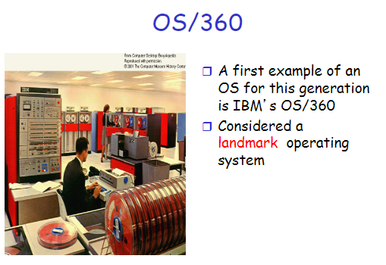
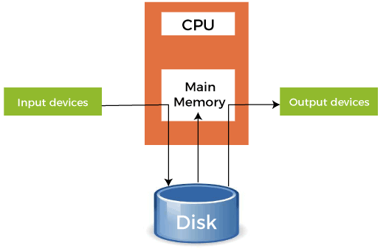
SPOOLING
Spooling stands for "Simultaneous Peripheral Operations Online". So, in a Spooling, more than one I/O operations can be performed simultaneously i.e. at the time when the CPU is executing some process then more than one I/O operations can also de done at the same time.
By spooling , the CPU will be in the execution phase most of the time. So, the CPU will not be idle in this case and this, in turn, increases the overall execution speed of the system.

Slide 19
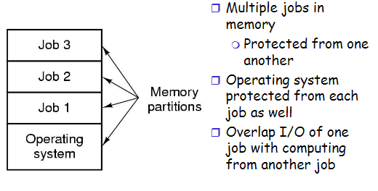
Third Generation: MULTI PROGRAMMING
Residing or Accommodation of more than one program at a time in Main Memory.
Multi programming has nothing to do with execution of programs.
What will be UNI Programming then??
Multiprogramming allowed several jobs to be active at one time.
Requires CPU Scheduling to choose which process to execute next.
The third generation computers used integrated circuits instead of transistors.

Slide 20
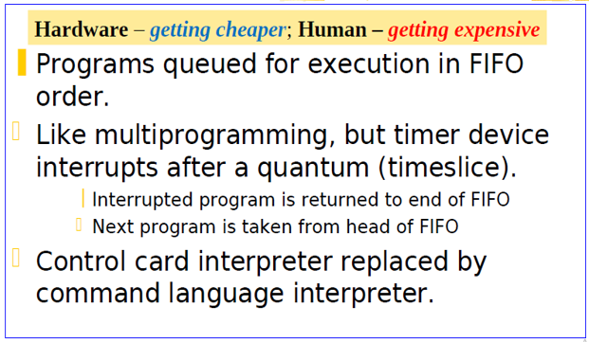
Third Generation: TIMESHARING
Time sharing is a logical extension of multiprogramming.
The CPU performs many tasks by switches are so frequent that the user can interact with each program while it is running.
Also known as Multitasking.
Interactive Operating System
Lesser Response Time
Lesser Waiting time

Slide 21
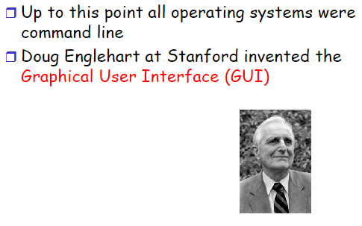
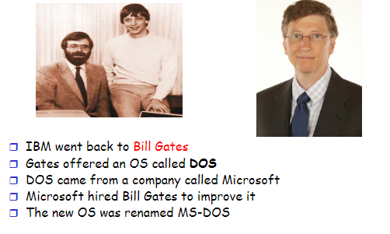
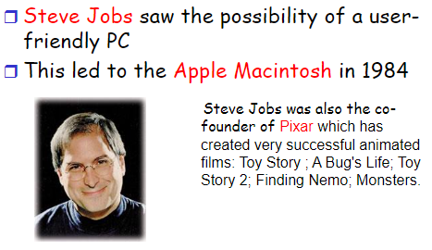
Fourth Generation: Personal Computing (PC)

Slide 22
